Slide 1



FUNDS LIQUIDATION DUE TO ACCOUNT HOLDER’S DEATH
Popular te apoya
a tu ritmo
POC Requirements

Slide 2
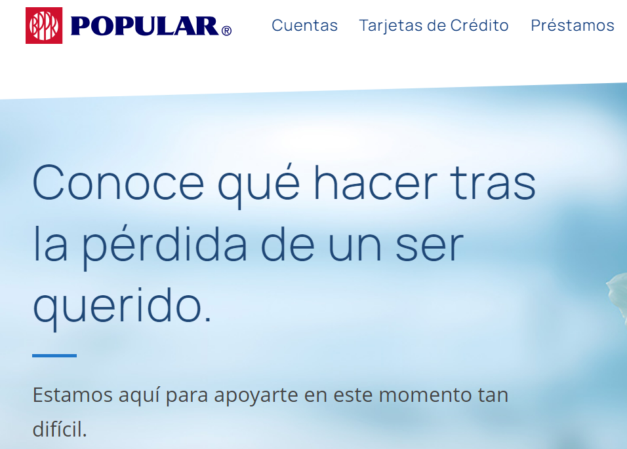

























Popular te apoya
General advancements and certification of bank relationship
Customer is redirected to web page: https://www.popular.com/processing-estate/
Where he can learn about advancements and Bank Relations Certificate.
a tu ritmo
PROCESS FLOW
No
Yes
Funeral expenses advance
Go to project requirements
Customer wants a liquidation of funds or funeral expenses advance
?
If the customer portal is created, it will require the customer to login to continue to fill the form and submit it.
Customer calls or searches how he can request a liquidation of funds due to death.
Customer finds web with info or call center rep guide tells the customer the web page with the information and interactive form.
To prevent errors, the form will be interactive making sure that the customers is only requesting a liquidation of funds
Yes
Cust answers to toAcct Balance at the death date was >$15K?
Don’t Know
Customer continues to fill the Form.
Yes
Evaluate if a child claim can be automatically created
No
Denied Letters:
Incomplete/wrong information
No available funds for disbursements
Accounts with more than 15K requires Estate Release
The customer must try again if we wants to continue with the claim
EP agent changed status to “Hold”, once this is solved the case can continue
The following message will pop out and it will let the customer continue:
If the balance at the date of death a Certificate of Release of Tax Lien with the Estate Tax Return will be required and will need submit anew request. We recommend that you request a certification of bank relationship
Estate Processing Supervisor Managers downloads reports of ticket status
The form will require Certificate of Release of Tax Lien with the Estate Tax Return in the disbursement information section
Yes
Acct has a Gvmt. deposit after date of death?
An email is triggered when the ticket is closed as denied indicating that the information submitted is incorrect or incomplete
Estate processing agent changes the status to denied and closes ticket
No
New document must be created with the purpose of al heirs authorizing the deposit into a particular account. In the future this document might be integrated with docusign.
The communication sent to the customers are saved on the ticket
No
Customer requested digital deposit?
Request is complete?
Estate processing agent reviews the document and information submitted. Also completes internal checks and creates additional requests if necessary.
Customer uploads required documents, based on the BRA-1032 document logic and the Release of Tax Lien explained explained in the previous step.
No
EP agent documents the instruction in case of disbursement and changes the resolution status to Approved Pick-up Check
Yes
An email is triggered letting the customer know that the claim was approved and the amount the was liquidated. If customer selected pick-up check, the notification will include the instructions
Yes
Customer receives email notification with ticket number.
Thank
you!
Customer submits form and the screen will show a thank you message and the SLA (24-48hrs) of the transaction
Estate processing deposits the claimed amount and closes ticket
Estate processing runs macro, creates other tickets (if necessary) and approves claim in Salesforce.
Ticket is assigned to the Funds Liquidation Due to Death Funds and is assigned to an Estate Processing Specialist
Support ticket is automatically created in salesforce with all the fields and documents submitted in the form.

Slide 3





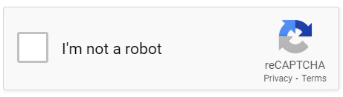
We are sorry for your loss, and we are here to support you during this difficult time.
Deceased customer information:
View “Pick-up at branch” was selected
First Name
Last Name
Disbursement Information:
What is your request?
First Name
Last Name
Account Holder Name
Disbursement Account Number
Select request type
Social Security Number
Date of Death
(DD)
(YYYY)
Funeral Home Name
Unpaid Invoice Amount Clamed
Social Security Number
Month
Day
Year
Disbursement Preference
Upload Death Certificate (PDF)
Select Disbursement preference
Options for the select box
Advance funds for unpaid funeral expenses
General advance of available funds or certification of bank relationship
Liquidation funds
Upload Death Certificate
Pick the branch town you wish to pick-up check:
Requestor information:
Select Branch
First Name
Last Name
First Name
Last Name
Pick the branch you wish to pick-up check:
If option #1:
Redirects to Project #2 portal
If option #2:
Please visit https:popular.com/processing-estate for more information.
Relationship
Email
Branch Name
Relationship
mailexample.com
Select Answer
Preferred Phone Number
Other Phone Number
Will all heirs be present when the picking-up the check?
Select Yes/No
Preferred Phone Number
Other Phone Number
Upload copy of requestor and all of the heirs ID
Where is located the heir that can’t be present at the moment of picking-up the check? (Select all that apply)
If option #3 is selected
Options for the select box
Account deposit
Pick-up at branch
Upload copy of requestor ID
Only show if customer answered “no” to previous question
Disbursement Information:
Active Duty in US Armed Forces
Disbursement Preference: Account deposit is only available for Popular accounts
Puerto Rico
You can request a liquidation of funds, it is important that you have these documents before proceeding
Death Certificate (original or copy)
Will documents:
Will in Puerto Rico
Will and the certification from the Registro de Poderes y Testamentos
Resolution of Testamentary Letters in case of Excecutor representing the Estate, according to the Testament
Will in USA
Last Will and Testament
Letters of Administration granted by Surrogate of Probate Court or subsititute document, in case of Small State Procedure
Without Will
Resolution of Declaration of Heirs
If the disbursement amount is greater than $15,000 Certificate of Release of Tax Lien with the Estate Tax Return that includes the Detalles de Bienes addendum
If you would like to the disbursement to be submitted in a particular account you will need to upload POPULAR DOC XXX
If you be picking up the check in a Popular branch you and not all of the heirs will be present you will need the following documents depending on the location of the heir that will not be present:
Active Duty in US Armed Forces, Military Power
Foreign Country, Apostille (note or explanatory letter) from the issuance country
Puerto Rico, Affidavit or Power of Attorney issued in Puerto Rico authorizing a third party to receive, endorse and/or exchange check because of the transaction
United States, Affidavit or Power of Attorney issued in United States and a Country Clerk Certificate from issuance state.
Select Disbursement preference
Unites States
Show if “Account Deposit” was selected
Account Holder Name
Disbursement Account Number
Foreign Country
Account Holder Name
Disbursement Account Number
Affidavit or Power of Attorney issued in Puerto Rico authorizing a third party to receive, endorse and/or exchange check because of the transaction
Popular Document where heirs authorized to disburse in the account
Only show if Puerto Rico was selected
Show this message if amount if “Yes”was selceted
Upload document
Upload document
Is the account balance at the death date was greater than$15K?
Select Answer
Select Yes/No/Don’t know
Only show if United States was selected
Affidavit or Power of Attorney issued in United States and a Country Clerk Certificate from issuance state
If the disbursement amount is greater than $15,000 a Certificate of Release of Tax Lien will be required.
Upload document
Show this message the customer answers “Don’t know”
If the balance at the date of death a Certificate of Release of Tax Lien with the Estate Tax Return will be required and will need submit anew request. We recommend that you request a certification of bank relationship
Only show if Foreign Country was selected
Apostille (note or explanatory letter) from the issuance country
Additional Required Documents:
Upload document
Select Answer
Options for the select box
Yes, Will in PR
Yes, Will in USA
No, without Will
Military Power
Select an answer
Is there a Will?
Upload document
Resolution of Declaration of heirs
Only show if option: No, without Will is selected
Upload document
Only show if Active Duty in US Armed Forces
Will
Upload document
Only show if option: Yes, Will in PR is selected
Additional Required Documents:
Certification from the Registro de Poderes y Testamentos
Only show if option: Yes, Will in PR is selected
For the additional required documents section follow same logic described in the previous screen
Upload document
Resolution of Testamentary Letters, if executor is representing the estate
Only show if option: Yes, Will in PR is selected. This field is not mandatory
Upload document
Select Answer
Last Will and Testament
Only show if option: Yes, Will in USA is selected
End form with security requirements detailed in screen 4
Do you have all the documents required, detailed above?
Select Yes/No
Upload document
reCAPTCHA helps prevent automated form spam. The submit button will be disabled until you complete the CAPTCHA.
If “No” is selected, show the following message:
In order to continue you must have the required documents.
If “Yes” is selected continue to the next page
Letters of Administration granted by Surrogate of Probate Court or substitute document, in case of Small State Procedure
Upload document
Only show if option: Yes, Will in USA is selected
Certificate of Release of Tax Lien with the Estate Tax Return, including Detalles de Bienes addendum
Legal,legal,legal,legal,legal,legal,legaLegal,legal,legal,legal,legal,legal,legal
Legal,legal,legal,legal,legal,legal,legal, Legal,legal,legal,legal,legal,legal,legal
Legal,legal,legal,legal,legal,legal,legal, Legal,legal,legal,legal,legal,legal,legal
Upload document
Only show if option the customer answered “Yes” regarding the disbursement is greater than $15,000.
Upload Popular’s Document: Requirements for Advancement or Disbursement of Deceased Customer Funds
I have read and accept the legal notification above
Submit
Upload document

Slide 4




CONT. WEB FORM
Your request is being processed. Case [Salesforce case number] was created.
Today you will receive an email confirming we got to your request with your ticket number. We will send the email to the one you input in the form
Your request should be processed by 20 business days. We will send you and email indicating if your request was approved or denied.
We couldn’t register your request
Something Happened! Your request was not able to be registered at this time, please try again in a few moments. Excuse the inconvenience and thank you for understanding.
Notes:
The webpage/form should be interactive as described in the previous slide. First questions are crucial for the process since the majority of rejected claims are because the invoice has already been paid.
Its important the page has some type of security before hitting submit, the visual representation of the form has reCAPTCHA security but any can be used. This is to prevent receiving false claims.
The customer will have the option to select the preferred language of the web form . Also, any message will consider the language previously selected.
Once the customer hit submit a ticket will be created in Salesforce with all the information submitted by the customer (including attached documents and copies of the emails sent to the customers).

Slide 5
BACKOFFICE WORKFLOW NOTES
Once the form is submitted, a ticket must be created with all the information submitted by the customer and must have the following status:
Workflow status- The only status that can be changed by an agent is Closed. The only status the customer can see in the portal is: New, In-progress and closed
New- This status is when the ticket just submitted and referred to the Liquidation of funds queue and the ticket owner field is blank.
In-progress- This status should be used when ticket has been assigned (ticket owner field has a value)
Hold-This status should be used when a government deposit was made after the death date and an investigation in required. Once the investigation is completed the agent can proceed with the disbursement process
Closed- This status will be picked by agent working on the case. It shouldn’t let the agent close the case if the resolution status is blank.
* See Backoffice Processing Section for additional rules of this status
Resolution Status- This can only be changed if the Workflow Status=In-progress
Denied- This status is picked by the agent working the case when the information and/or documents are wrong or incomplete.
Denied-No Funds Available- This status is picked by the agent working the case when there are no available funds in account.
Denied-Funds Exceed $15K -This status is picked by the agent working the case when the disbursement amount is greater than $15K and the proper documentation was not uploaded
Approved-Deposit- This status is picked by the agent working the case when the information and documents are correct, and the claimed amount was deposited.
Approved-Pickup Check- This status is picked by the agent working the case when the information and documents are correct, and the customer must go to the selected branch to pickup the check.

Slide 6
Backoffice Processing
Below details of additional fields and checklist needed in the employee case view. Also, it specifies additional status rules:
All the data input by the customer in the form should me mapped to a case (claim) in Salesforce.
Additional fields that will be needed that are not in the customer webform are:
Closed Date- Automatically generated when ticket status is set to closed
Customer Pickup Date- manually inserted by user
Case Owner Name-input by user
Assigned Date- Automatically generated when ticket is assigned
Amount Disbursed-Input by user
Additional to the fields described above, a checklist (with its corresponding fields) will be created to make sure the Estate Processing Specialist completes all the steps
Credit cards coded and closed as deceased. If not create PCAS ticket for this.
Verify if accounts are coded deceased, 43 and if the deceased customer has CD and/or IRA. If not create JIRA ticket for deceased codification, 43 and DLG configuration.
Verify government deposits after the date of death. The following questions with options should appear when adding the checkmark:
Government deposit after date of death with Yes/No option.
PCAS ACH Claim Open with Yes/No option.
ACH Claim Status with: In progress/ Completed option.
Additional workflow status and ACH Claim status rules:
Automatically change ACH Claim Status to In Progress, when PCAS ACH Claim Open is answered “Yes”.
Workflow status should automatically change to Hold when ACH Claim Status= In Progress
Workflow Status should automatically change to In Progress when Status of ACH Claim=Completed
All main 3 checkmarks must be completed to close ticket. If “Yes” was selected for government deposit after date of death, Status of ACH Claim should be “Completed” also to close ticket.

Slide 7




NOTIFICATIONS
Below is a sample of the email the customer will receive during the process as showed in the process flow. There are a total of 3 emails:
Email request confirmation
Email rejecting/denying the request (has 3 versions)
Incomplete/wrong information
No available funds for disbursements
Accounts with more than 15K requires Estate Release
Email approving the request (has 2 versions)
Approved-Deposit
Approved-Pickup check
Use a no-reply email
Each notification should be stored to its corresponding ticket in Salesforce
Denied-Incomplete Wrong Information
Approved-Deposit
Hi [Requestor First Name]:
We are sorry for your loss and we are here to support you in these process. We have received your Liquidation Funds request. Your ticket number is [Salesforce ticket number] and you may use it as reference. We will review the submitted documentation and information and send you an email with the resolution of your request.
If you have any questions, you can contact us at 787-724-3650 or visit one of our branches.
We are here to serve you;
Banco Popular de Puerto Rico
Hi [Requestor First Name]:
We understand that this is a challenging time for you, and we want to extend our sincerest condolences. Our team is committed to supporting you throughout this process. Upon reviewing your Liquidation Funds request under ticket [Salesforce ticket number], we regret to inform you that we are unable to proceed at this time. The documentation provided is either incorrect or incomplete.
Please review the information and if you wish you can submit another request.
If you have any questions, you can contact us at 787-724-3650 or visit one of our branches
We are here to serve you;
Banco Popular de Puerto Rico
Hi [Requestor First Name]:
Please accept our deepest condolences for your loss. We are here to provide you with the support you need during this difficult time. We have completed the review of your Liquidation of Funds request under ticket [Salesforce ticket number], and we are pleased to confirm that it has been approved. The amount of [Amount Claimed] has been deposited into the account ending in [Account Holder Number].
If you have any questions, you can contact us at 787-724-3650 or visit one of our branches
We are here to serve you;
Banco Popular de Puerto Rico
Hi [Requestor First Name]:
Please accept our heartfelt condolences during this difficult time. We are here to offer our full support. We have carefully reviewed your Liquidation Funds request associated with ticket [Salesforce ticket number], and we are pleased to inform you that it has been approved. Your check is now available for pick-up at our [Branch Name] branch in [Branch Town].
We kindly ask you to bring a valid form of identification and mention the ticket number upon arrival. If there’s anything more we can do to assist you, please don’t hesitate to reach out
We are here to serve you;
Banco Popular de Puerto Rico
Denied-No available funds
Hi [Requestor First Name]:
We understand that this is a challenging time for you, and we want to extend our sincerest condolences. Our team is committed to supporting you throughout this process. Upon reviewing your Liquidation Funds request under ticket [Salesforce ticket number], we regret to inform you that we are unable to proceed at this time, because there no funds to be disbursed.
If you have any questions, you can contact us at 787-724-3650 or visit one of our branches
We are here to serve you;
Banco Popular de Puerto Rico
Approved-Pickup check
Denied-Funds exceed 15K and more documentation is needed
Hi [Requestor First Name]:
We understand that this is a challenging time for you, and we want to extend our sincerest condolences. Our team is committed to supporting you throughout this process. Upon reviewing your Liquidation Funds request under ticket [Salesforce ticket number], We regret to inform you that we were unable to proceed because the disbursement amount is greater that $15,000 and you need to submit a Certificate of Release of Tax Lien.
Once you have it you can submit another request.
If you have any questions, you can contact us at 787-724-3650 or visit one of our branches
We are here to serve you;
Banco Popular de Puerto Rico

Slide 8
NOTIFICATION TRIGGERS
Below are the notification triggers:
# | Letter | Trigger
1 | Request Confirmation | Once the ticket is created in Salesforce and a ticket number has been assigned
2 | Denied Request-Incomplete/ Wrong Information | Once Workflow Status=Closed and Resolution Status=Denied-No Funds Available
3 | Denied Request- No funds Available | Once Workflow Status=Closed and Resolution Status=Denied
4 | Denied Request- Funds Exceed $15K | Once Workflow Status=Closed and Resolution Status=Denied-Funds Exceed $15K
5 | Approved Request-Deposit | Once Workflow Status=Closed and Resolution Status=Approved-Deposit
7 | Approved Request-Pickup Check | Once Workflow Status=Closed and Resolution Status=Pickup Check

Slide 9
PENDING ITEMS NOT INCLUDED IN THE POC
Legal and marketing approval of: process, forms and customer notifications
Legal information that must be included on the form page
Creation of new documents, we discussed that it is possible a new document will be created for all heirs to approve the disbursement to be deposited into a single account
Other processes related to decease requests

Slide 10
APPENDIX

Slide 11
NOTIFICATIONS
Below is a sample of the email the customer will receive during the process as showed in the process flow. There are a total of 3 emails:
Email request confirmation
Email rejecting/denying the request (has 3 versions)
Incomplete/wrong information
No available funds for disbursements
Accounts with more than 15K requires Estate Release
Email approving the request (has 2 versions)
Approved-Deposit
Approved-Pickup check
Use a no-reply email
Each notification should be stored to its corresponding ticket in Salesforce
Denied-Incomplete Wrong Information
Approved-Deposit
Hi [Requestor First Name]:
We are sorry for your loss and we are here to support you in these process. We have received your Liquidation Funds request. Your ticket number is [Salesforce ticket number] and you may use it as reference. We will review the submitted documentation and information and send you an email with the resolution of your request.
If you have any questions, you can contact us at 787-724-3650 or visit one of our branches.
We are here to serve you;
Banco Popular de Puerto Rico
Hi [Requestor First Name]:
We understand that this is a challenging time for you, and we want to extend our sincerest condolences. Our team is committed to supporting you throughout this process. Upon reviewing your Liquidation Funds request under ticket [Salesforce ticket number], we regret to inform you that we are unable to proceed at this time. The documentation provided is either incorrect or incomplete.
Please review the information and if you wish you can submit another request.
If you have any questions, you can contact us at 787-724-3650 or visit one of our branches
We are here to serve you;
Banco Popular de Puerto Rico
Hi [Requestor First Name]:
Please accept our deepest condolences for your loss. We are here to provide you with the support you need during this difficult time. We have completed the review of your Liquidation of Funds request under ticket [Salesforce ticket number], and we are pleased to confirm that it has been approved. The amount of [Amount Claimed] has been deposited into the account ending in [Account Holder Number].
If you have any questions, you can contact us at 787-724-3650 or visit one of our branches
We are here to serve you;
Banco Popular de Puerto Rico
Hi [Requestor First Name]:
Please accept our heartfelt condolences during this difficult time. We are here to offer our full support. We have carefully reviewed your Liquidation Funds request associated with ticket [Salesforce ticket number], and we are pleased to inform you that it has been approved. Your check is now available for pick-up at our [Branch Name] branch in [Branch Town].
We kindly ask you to bring a valid form of identification and mention the ticket number upon arrival. If there’s anything more we can do to assist you, please don’t hesitate to reach out
We are here to serve you;
Banco Popular de Puerto Rico
Denied-No available funds
Hi [Requestor First Name]:
We understand that this is a challenging time for you, and we want to extend our sincerest condolences. Our team is committed to supporting you throughout this process. Upon reviewing your Liquidation Funds request under ticket [Salesforce ticket number], we regret to inform you that we are unable to proceed at this time, because there no funds to be disbursed.
If you have any questions, you can contact us at 787-724-3650 or visit one of our branches
We are here to serve you;
Banco Popular de Puerto Rico
Approved-Pickup check
Denied-Funds exceed 15K and more documentation is needed
Hi [Requestor First Name]:
We have reviewed your Liquidation Funds request under the ticket [Salesforce ticket number] and unfortunately, we can’t process it because the disbursement amount is greater that $15,000 and you need to submit a Certificate of Release of Tax Lien.
Once you have it you can submit another request.
If you have any questions, you can contact us at 787-724-3650 or visit one of our branches
We are here to serve you;
Banco Popular de Puerto Rico
Eliminar???

Slide 12
MEETING NOTES
Adelanto de fondos: Gastos Funebres
Documentos requeridos
Certificado de Defuncion
Factura de la funeraria a nombre del cliente fallecido, Recordatorio la factura no debe de estar pagada ya
Copia de ID del soliciante con foto o pasaporte(Validar)
Al principio poner unas preguntas para ver si es un Adelanto de fondos o pago funebre
Proceso digital
Cliente complete formulario (que campos debe de poner)- usar los de la forma
Otros: cantidad de la factura, y salga mensaje si
Tener de que forma quiere que se le entregue: digital (cuenta de banco de funeraria, o cheque)
Estan validando si esto es viable.
Si es cheque, seleccionar pueblo, seleccionar succursal (junto con search bar)
Somete los documentos requeridos
Si es sobre 15K, que le salga un mensaje. Validar si solo se pagara 15
Le da submit y recibe un email con la solicitud, 24-48 horas
Departamento Centralizado (Validar que equipo seria) ¿Deposit Operations o Estate Processing?
Se crea ticket en PCAS
De tener todos los documentos y estar completos procede a hacer el proceso de deposito de banco si el cliente selecciono digital
Si el cliente selecciono cheque, enviar email a gerente y subgerente . Cambia el estatus del ticket (Validar estatus de PCAS
Cliente recibe email de transacción aproba
Razones para denegar fondos funebres:
Factura de funeraria pagada
No todos los documentos estan
Preguntas: Validar si la hoja 1032-tiene que ser completada para Adelanto de gastos funebres- Bryan y Perla verificaran – Lo validamos y nos dijeron que no es necesario llenar la BRA-1032

Slide 13
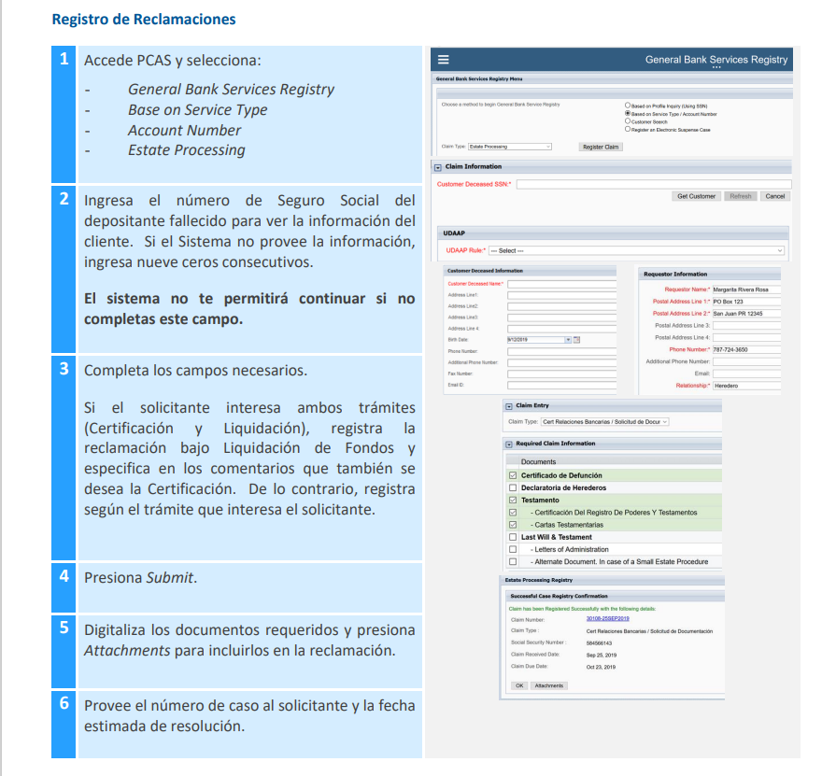

Slide 14
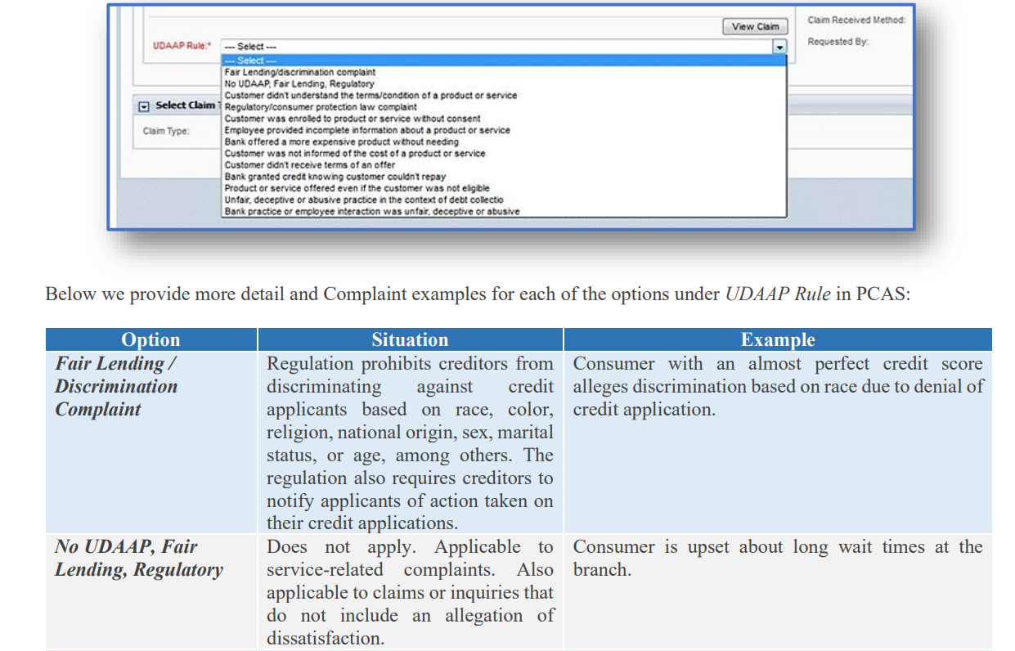

Slide 15
